Slide 1
Quality Tuning for Diffusion Models
Deploying quality tuning on base model and comparing the accuracy and inference of both models

Slide 2
Stable Diffusion XL
Efficient at higher resolutions
Max resolution of SD 1.5 is 512p while SDXL provides 1024p
Refiner
Used to improve image quality
Fixes anomalies generated by AI
# Load the DiffusionPipeline model
pipe = DiffusionPipeline.from_pretrained(
"stabilityai/stable-diffusion-xl-base-1.0",
vae=vae,
torch_dtype=torch.float16,
variant="fp16",
use_safetensors=True
)
from diffusers import StableDiffusionXLImg2ImgPipeline refiner = StableDiffusionXLImg2ImgPipeline.from_pretrained(
"stabilityai/stable-diffusion-xl-refiner-1.0",
vae=vae,
torch_dtype=torch.float16,
use_safetensors=True,
variant="fp16",
)
refiner.to("cuda"); image = refiner(prompt=prompt, num_inference_steps=25, generator=generator, image=image)
image.images[0].resize((300, 300))

Slide 3
# Load the AutoencoderKL model
vae = AutoencoderKL.from_pretrained(
"madebyollin/sdxl-vae-fp16-fix",
torch_dtype=torch.float16
)
Auto encoder
VAE (Variational Auto Encoder)
Used for efficient encoding and decoding of images
Our custom VAE model makes use of fp16 precision
FP16 Precision
Helps in managing GPU memeory efficiently
Allows execution of larger models on consumer grade hardware without running into emmeory issues
Reduces overall resource consumption
Autotrain
Simplifies the process of training and deployimg machine learning models
Automates variour processes such as hyperparameter tuning and dataset management.
GPU acceleceration
CUDA allows for parallel processing on NVDIA GPUs
This speeds up the training and inference processes
!pip install GPUtil import torch
from GPUtil import showUtilization as gpu_usage
from numba import cuda def free_gpu_cache():
print("Initial GPU Usage")
gpu_usage() torch.cuda.empty_cache() cuda.select_device(0)
cuda.close()
cuda.select_device(0) print("GPU Usage after emptying the cache")
gpu_usage() free_gpu_cache()

Slide 4
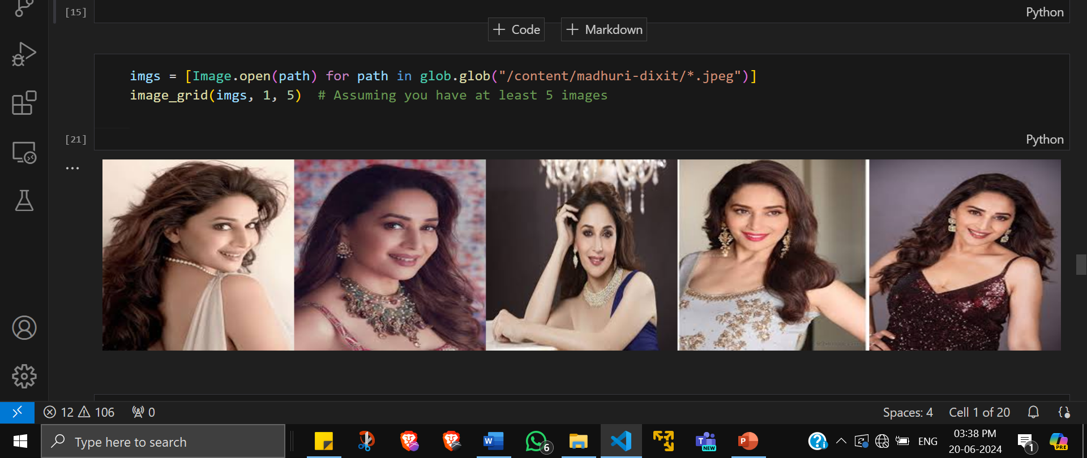
Prompt : Generate 2 images of Madhuri Dixit Running a marathon

Slide 5
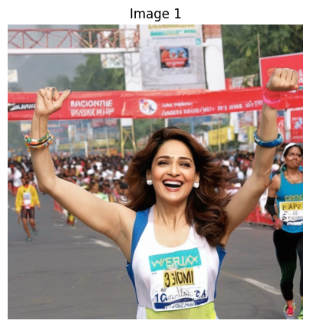
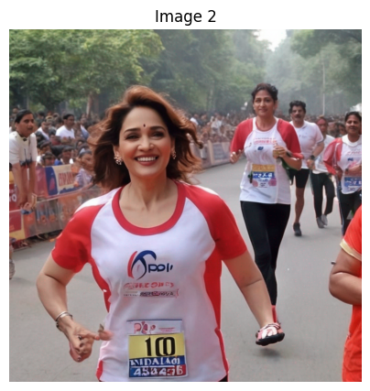
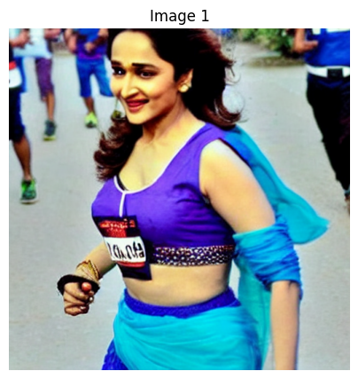
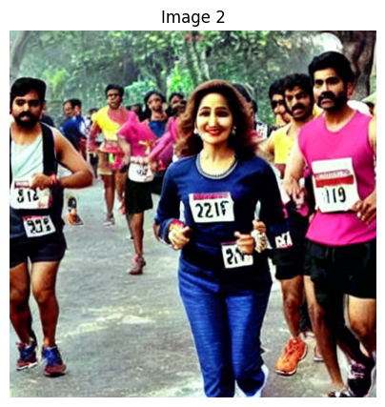
Generated by base model
Generated by our quality tuned model

Slide 6
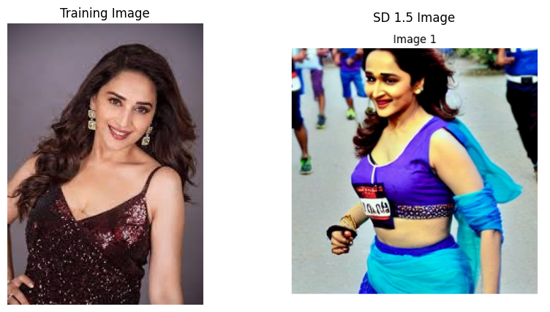
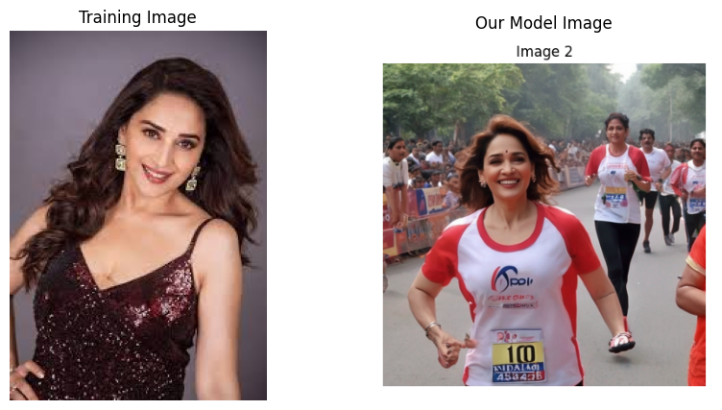
SSIM = 0.22
Higher SSIM values indicate greater similarity, while lower values indicate more significant differences.
SSIM = 0.27

Slide 7
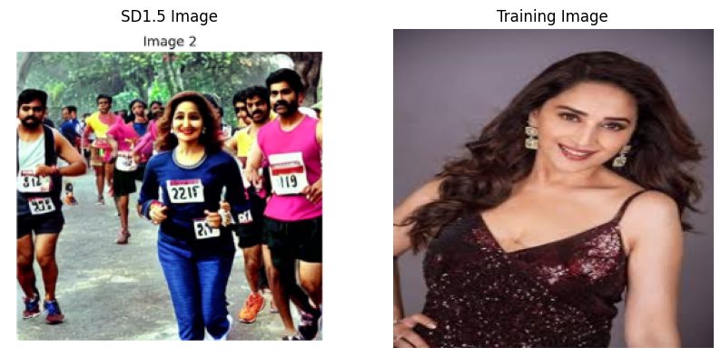
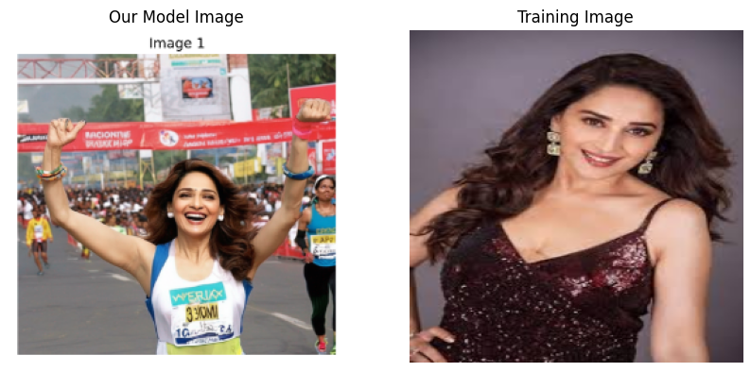
PSNR value is 9.2483 dB
PSNR measures the difference between the original and generated images in terms of pixel intensity.
Higher PSNR values indicate better quality.
PSNR value is 10.1337 dB

